Slide 1

MOVIE STREAMING DATABASE
Ivan Stakhov

Slide 2




TOPIC
This is a PostgreSQL relational database designed to model a real-world movie streaming platform like Netflix / Hulu / Disney+.
This topic is medium difficulty, fits all course requirements, and is not taken by anyone else in your list.

Slide 3

REQUIREMENTS & USE CASES
• Manage users, subscription plans, movies, genres, watch history, and ratings
• Ensure data integrity via primary keys, foreign keys, and constraints
• Support queries for trending movies, popular genres, active users, churn risk
• Provide a normalized schema and ER-diagram, SQL scripts, transactions, and backup strategy

Slide 4
DATABASE DESIGN
01
Tables: user_account, subscription_plan, subscription, movie, genre, movie_genre, watch_history, rating, device
Primary keys uniquely identify rows; foreign keys enforce relationships
02
Normalization to at least 3NF; separate tables handle many-to-many (movie–genre)
See ER-diagram (docs/erd.png) for relationships and cardinalities

Slide 5
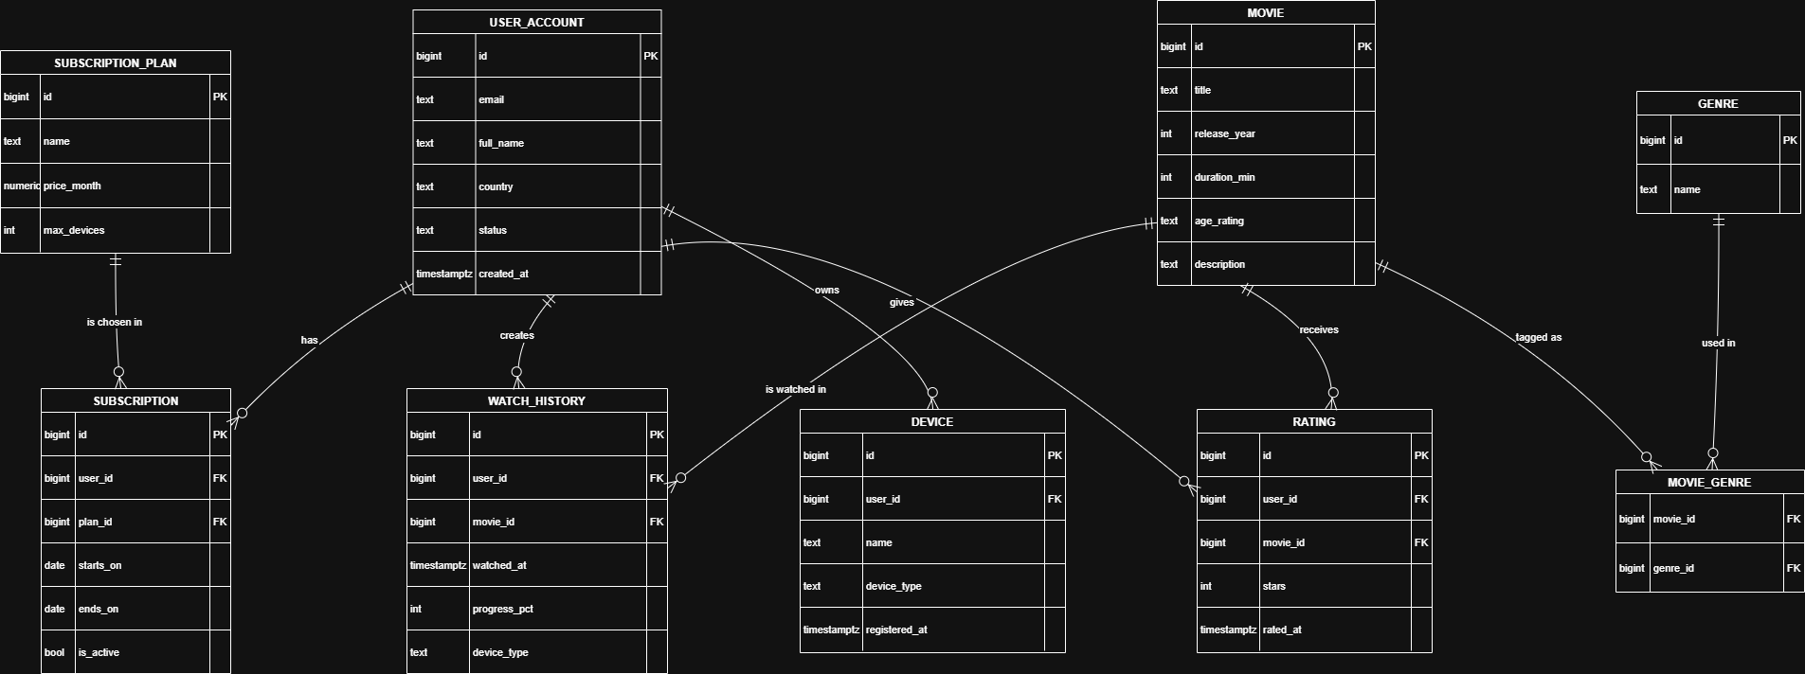

Slide 6

OVERVIEW
01_schema_creation.sql: defines tables, constraints, and indexes
02_data_insertion.sql: populates tables with sample data
03_logic_and_views.sql: function, trigger, and reporting views
04_queries_basic.sql / 05_queries_advanced.sql: example queries
06_transactions_and_indexes.sql: transactions and index usage

Slide 7
RESULT
01
02
03
• Basic queries: SELECT, INSERT, UPDATE, DELETE, joins
• Advanced queries: GROUP BY, CTEs (WITH), window functions (RANK, ROW_NUMBER)
• Analytical reports: trending movies, popular genres, active users, average ratings
• Demonstrate ACID properties: BEGIN, COMMIT, ROLLBACK, SAVEPOINT
• Example transaction: upgrade a user subscription safely
• Example SAVEPOINT scenario: insert multiple watch events and undo one
• Indexes on watch_history (user/time), subscription (user/active), rating (movie)
• Use EXPLAIN ANALYZE to show index scans and performance impact
• Queries target normalization and performance using indexes and views

Slide 8

QUESTION
TIME

Slide 9
THANK YOU
For your attention

